Slide 1
Buy Extra Stove or Canister
New Feature Requirement

Slide 2
Vision
Allow customers who have already purchased an initial kit to buy extra canisters and/or stoves
Feature Solution
Solution options:
myKOKO (future)
KOKOfuel.co.ke (future)
KP App (as a start)]
Integration with KC and Odoo
Data Points
KOKO core- customer information
Odoo configurations of products
Facilitate fulfillment of this products on KP
Selling price of individual products
Business Goals
Allow customers to purchase more than one canister or stove.
Ensure internal product usage is accounted for using formal processes
Key Principles
All new products should come from Odoo inventory.
When items are fulfilled on the KP the NFC tag is assigned to the user in KC.
Reassignment of canisters will continue to happen in KC and not reflect in Odoo.
Target Users/ Scenarios
Consumers who have previously purchased a kit and would like to purchase an extra canister.
Internal users who need a canister or kit for demo / ops / testing purposes
Needs
A catalog which allows a user to select products that we are selling- Kit, Stove or Canister. This is not dependant on whether a customer has previously fulfilled a kit.
Allow for fulfillment of extra items on KP.
Remove ‘inventory’ concept on KP including the ability to create a new item.

Slide 3
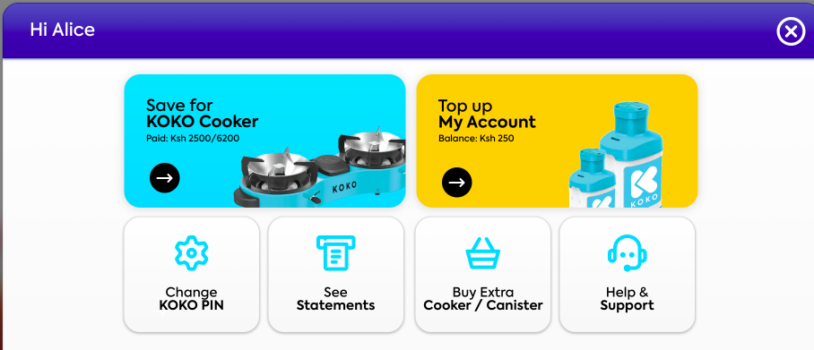
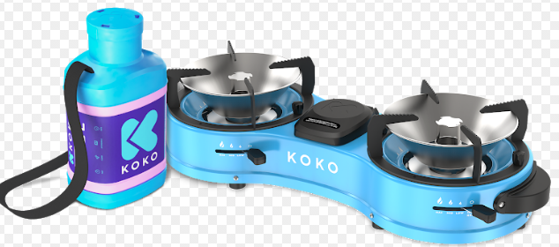
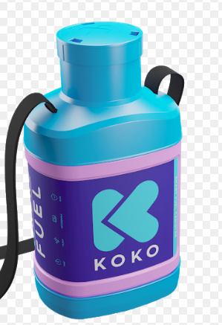
In Scope
Not In scope
External customers and internal users with accounts can buy additional products on the KOKOpoint
All products need to be paid for in the system for accounting processes
Remove legacy code in KC allowing us to create KIT inventory in KC - only canisters should stay in KC
Update legacy functionality in KC e.g. search for canister items needs updating to reflect new serial ID formats
Customers should be allowed to buy new products as long as they have fully paid for their previous orders (but ok for them not to have fulfilled).
An interface on KOKO Core for internal users to create orders for products. Internal users will use customer facing apps to create and fulfil orders. IMPLICATION: They are using their work accounts, not their personal accounts.
At the moment we are only selling kits and canisters; expectation is this design and architecture is extensible for future products (KOKO or external) but we are not them into the catalogue as part of this work package.
Ksh 6999
Ksh 999

Slide 4
Solution / Process
On the KP App, the customer logs in, then gets the Buy Extra Cooker or canister button
On click, they are taken to a products page showing stove, canister or kit and prices
The customer chooses the product they would like to purchase.
Buy now and start saving options.
Payment process as in buy cooker journey (MPESA)
Pre-Order generated in KOKO Core
Order generated in Odoo when payment is complete
Fulfillment process as-is currently
If fulfilling kit or canister product, canister NFC tag is pulled as in the current process.
User interface
KOKO Core
Odoo

Slide 5
High Level Journey - Buying
Edge Cases / Things to test
What happens if a customer has an account but isn’t a stove user?
How does the select item functionality behave if the product can only be sold as single items?
How does the product catalogue look if there are only 1/2/3/4 and 5 products?
Product API doesn’t return items on product catalogue page (network error or other)
Customer visits the KP
Log into account on KP
Select buy KOKO products
Select item from product list
Select quantity
Select payment option
View top up instructions
Order placed

Slide 6
High Level Journey - Collection (Fulfilment)
Edge Cases / Things to test
Canister not at this KP the customer is fulfilling at
Customer does not have an order when trying to fulfil
Test fulfilling an order with multiple products
Customer typed in wrong serial ID
Customer goes to Collect ‘Order’ on KP
Log In
Select order to collect
Enter item serial ID
>1 item to collect?
No
How To Video*
Yes
Fulfilment complete
Proceed to buy fuel screen

Slide 7
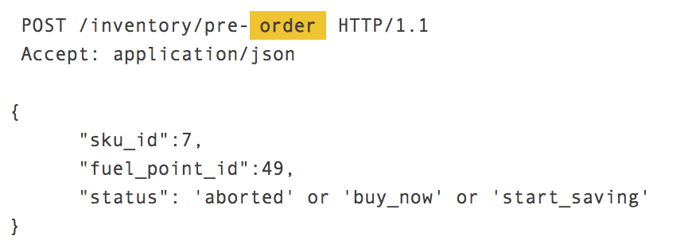
Buying API changes
The buying APIs manage the creation of a pre-order for a KOKO Cooker.
Currently if the customer has a balance > than the order value an order is created straight away.
A pre-order can only be created for one product at a time.
Changes:
Option 1: Allow for multiple pre-orders to be created for each item
Option 2: All for one pre-order with multiple items to be created
KP
KOKO CORE
ODOO
/v2/kp/inventory/pre-order
/api/v1/customer/purchase-product
No change
Notes:
HI Alice. /inventory/fulfill-order would just do the KC to Odoo call.

Slide 8
Fulfilment API
The fulfilment APIs manage the fulfilment of a kit:
The KP sends the KIT serial ID to Odoo via KOKO Core.
The KIT Serial ID is found in the ‘kit tracker’.
The Item is fulfilled in Odoo and the NFC tag is pushed to KC for future log-ins.
We need to allow for canister fulfilment in the same way. This includes extending the existing fulfillment API to allow for canister serials and a look up in a ‘canister tracker’.
N.B. Fulfilment of an item can also be triggered directly from KOKO Core but do we want the Ops teams to be able to use this functionality?
KP
KOKO CORE
ODOO
/kp/customer/item-fulfillment-confirmation
api/v1/customer/order-fulfillment
Notes:
HI Alice. /inventory/fulfill-order would just do the KC to Odoo call.

Slide 9
Summary of user stories / dev tasks
User Need | KOKOpoint app + KOKO Core | Odoo
View product list | New UI, amend product API to get description | Add additional canister product to Odoo
View product detail | New UI
Select quantity | New UI, amend product API to check how many of the item can be sold | Add buyable quantity at product level in Odoo
Select payment option | New UI
View MPESA instructions | Copy existing UI and integrate with journey
Place order | Order complete UI, place order for individual / multiple items, SMS confirmation to customer | Allow an order to be placed with multiple items
Allow fulfilment of multiple items | UI tweaks, changes to API to understand how many items a customer is fulfilling | Allowing for multiple items to be fulfilled in a loop
Planned for Sprint 132
29th Jul - 9th Aug

Slide 10
Key business rules
Customers can place orders with multiple items > these will be created as individual pre-orders in KOKO Core & Odoo
Customers will collect each item individually as per today’s process
Customers will only be allowed to collect items once they have paid the full order value.
Customers will not be allowed to save for an order with more than one item.
If you have existing pre-orders you will not be able to place further pre-orders; but you can have multiple pre-orders open at a time.
Canisters= 10
Stoves = 2

Slide 11
Process for internal users
Team needs new item e.g. canister for calibration
Team orders new item on KP
Internal user requests a admin top up from Finance
Finance credit internal users work account
Internal user collects item from the KP
Assumptions:
Internal users use customer processes to get new items
They are using their KOKO Core ‘work’ accounts not their personal customer accounts.
Product will need to lead on documenting and training for this new process with support from Ops

Slide 12
Implementation Plan
Sprint 133 / R23
Sprint 132 / R22 but to be release in R23
Phase 3: Adapt fulfilment journey
Phase 2: Adapt buying APIs to manage multiple items
MVP: Buying journey for extra products on KP app, adding product description

Slide 13
High level user stories / dev tasks
As a customer I want to be able to buy multiple items in one order so I don’t need to keep going through the buying journey multiple times - Tushar / Daniel
As KOKO I want to be set a rule on how many items a customer can buy - Peter / Akshay
As a customer I want to be able to select which item in my order I want to collect on the KP so that I can fulfil my order.- Ronnick + Valentine; Tushar / Daniel
As a customer I want to link my canister to myself in fulfilment so it can be used for future logins - Peter / Akshay
Update search functionality in KOKO admin - Tushar / Daniel
Remove legacy inventory items from KOKO Core - Sameer
Reporting requirements - Athena queries - can do next week

Slide 14
Data and Monitoring Requirements
Feature KPIs
Order volumes split by quantity and product
Volume of customers who are buying the same product repeatedly
Fuel usage of customers who are buying multiple canisters
Volumes of customers saving for additional products
These would be driven via Athena data feed.
User experience level monitoring
Volume of customers selecting buy extra product on the my account screen first time
Customers clicking back on the payment page
Users exiting on any of the pages

Slide 15
Questions
Do we want to limit the number of canisters a customer can buy? [Matt / Sagun]
Do we want to limit the number of kits a customer can buy? [Matt / Sagun]
How much does a canister retail for? And what are the VAT implications? [Amar / David]
Should customers collecting canisters watch the how to videos? [Matt / Sagun]
Should customers collecting be directed them from collect journey into the buy fuel journey as we do for stoves? [Matt / Sagun]
How should we model the admin top ups that pay for internal users items? [Amar / David]
When do these journeys need to be on the kokofuel.com and myKOKO? [Matt / Sagun]
How will we model orders for multiple items? Single order with multiple items? Changes to KOKO Core [Amar]

Slide 16
Designs for front end UI

Slide 17
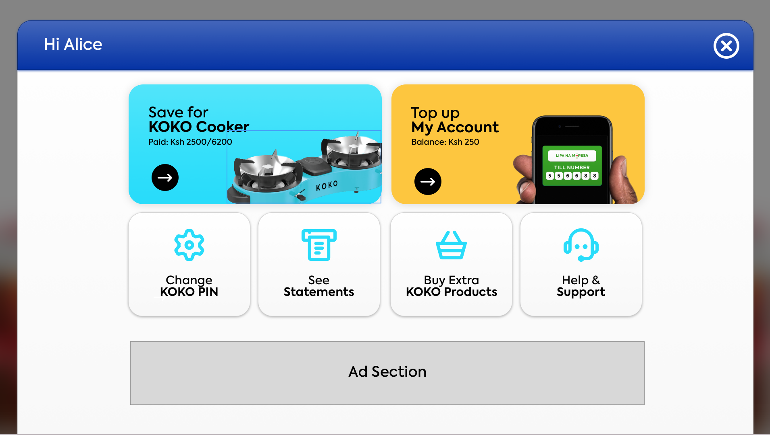
View my account page

Slide 18
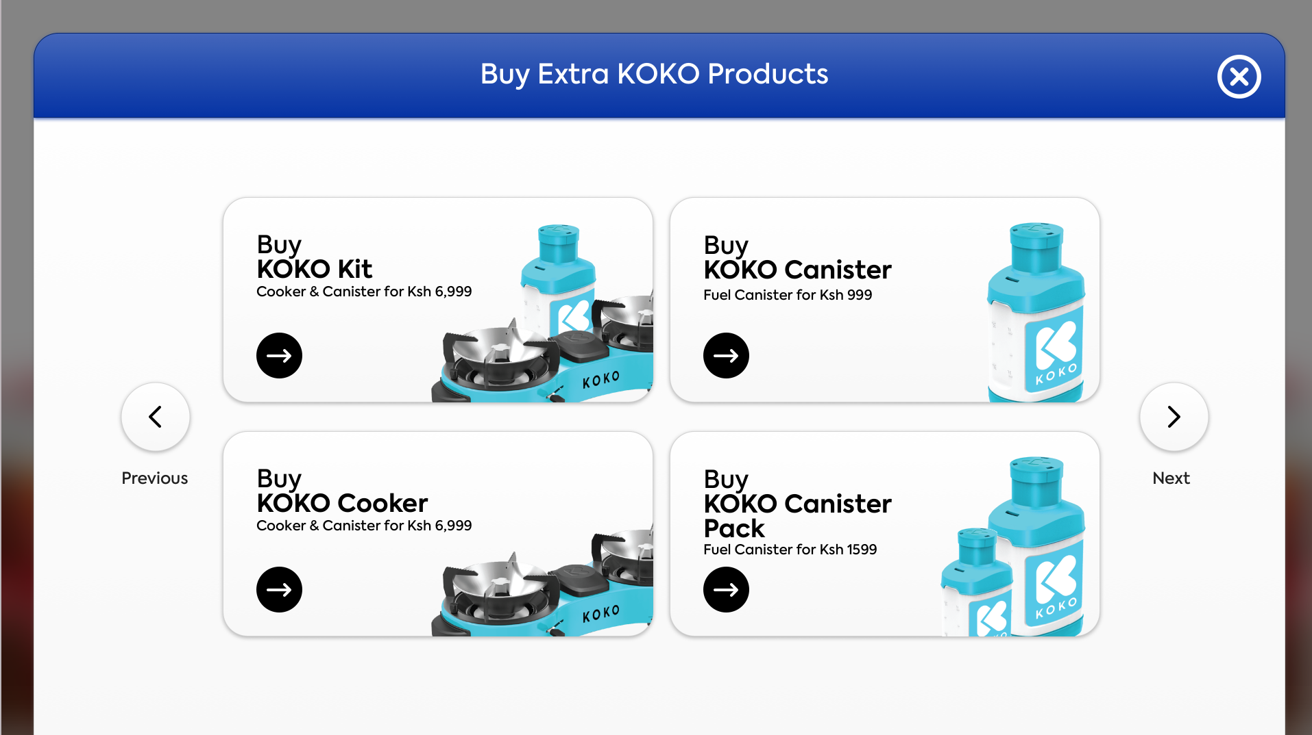
Product Catalogue Page

Slide 19
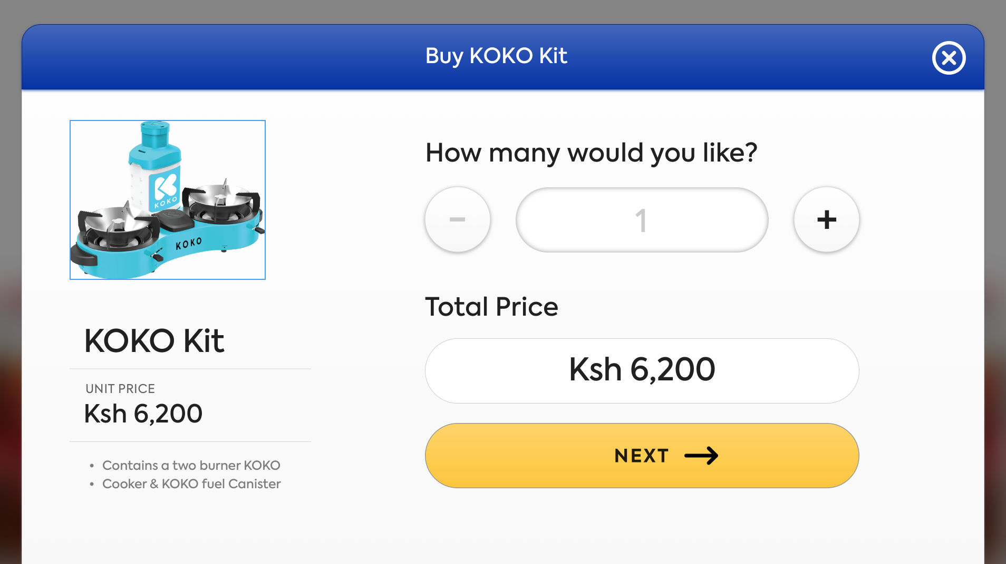
Product Detail Page

Slide 20
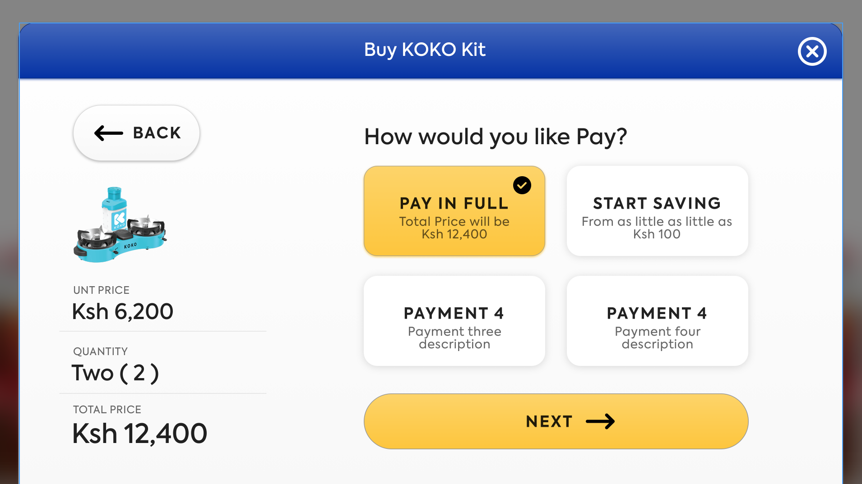
Payment Options

Slide 21
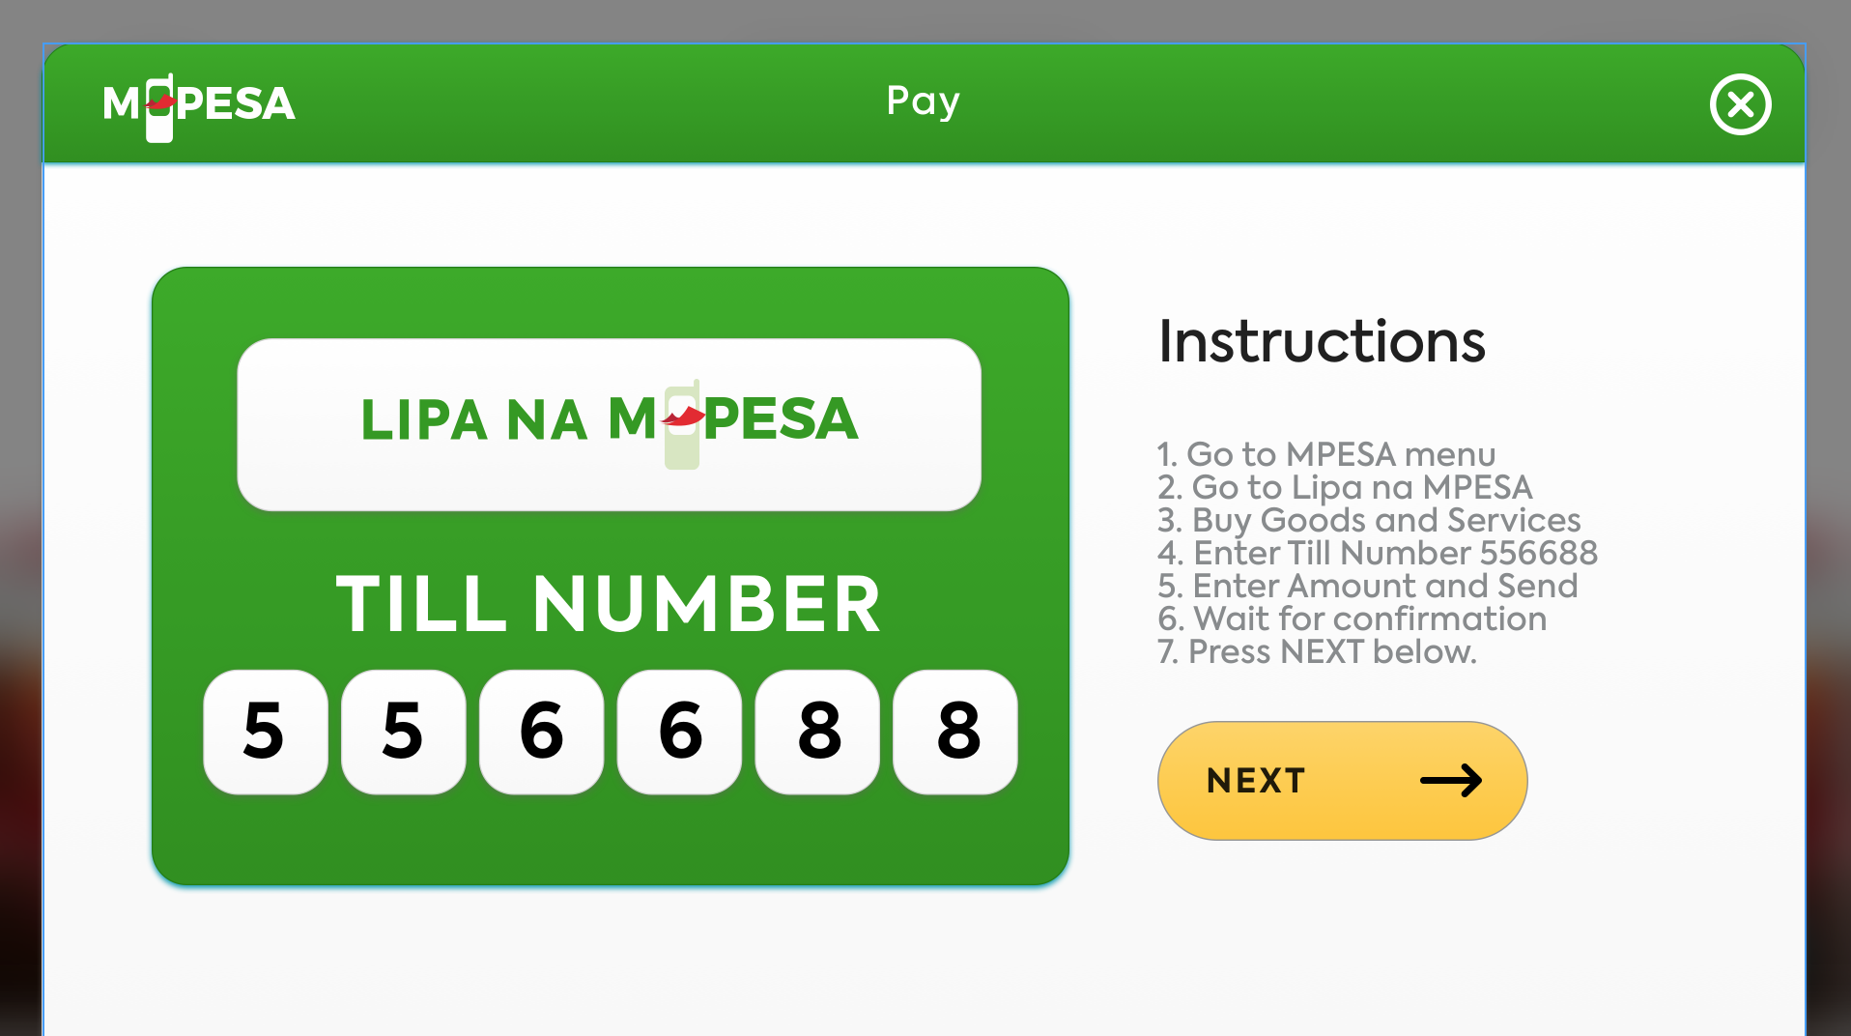
Payment Instructions

Slide 22
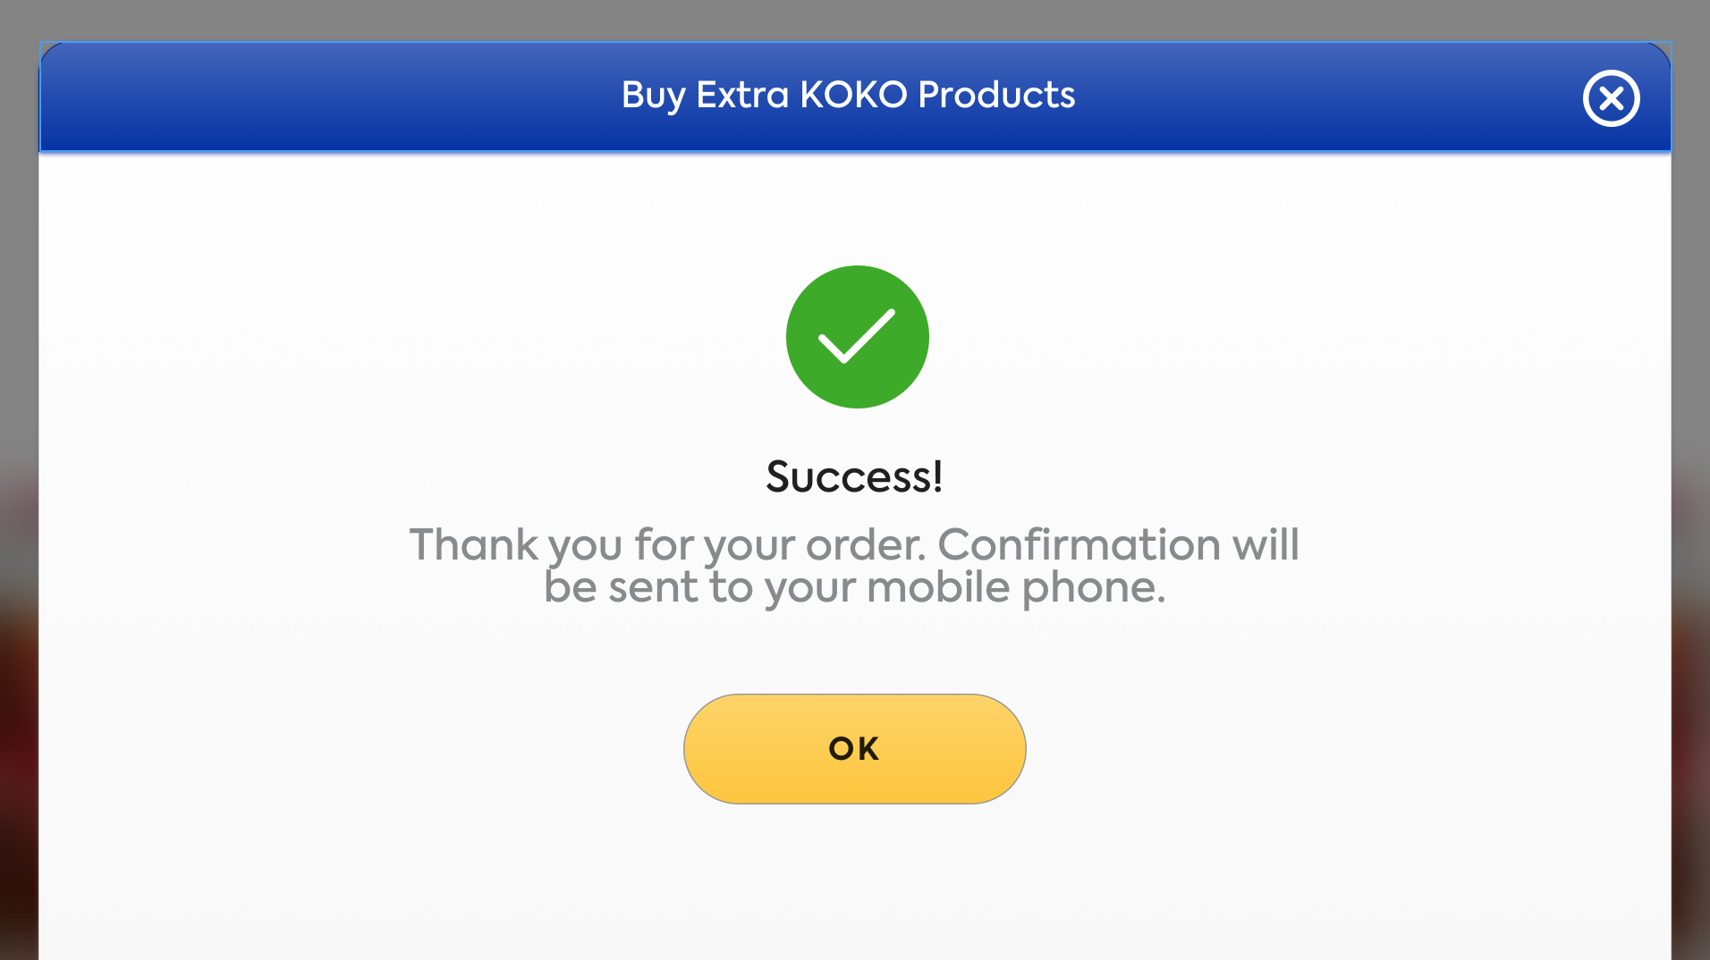
Order Confirmation

Slide 23
Links to designs on zeplin
KP Designs
Website Designs

Slide 24
High Level Journey - Collection (Fulfilment)
Edge Cases / Things to test
Canister not at this KP the customer is fulfilling at
Customer does not have an order when trying to fulfil
Test fulfilling an order with multiple products
Customer typed in wrong serial ID
Customer visits the KP
Select Collect Item
Log In
Enter item serial ID
>1 item to collect?
No
How To Video*
Yes
Fulfilment complete
Example: If the customer has three orders they enter the serial ID of each item and then they are prompted to collect their next item. They are only taken to the how to video when they have entered the serial ID of their 3rd item.
Proceed to buy fuel screen

Slide 25
Select order to fulfill - draft
https://app.zeplin.io/project/5d5bc91cc463d49b78e82aad

Slide 26
Fulfil another order
Success!
Do you have another item to collect?
No
Yes

